Slide 1
ELD A+ Project 8-point FFT using HLS
Rahul Kumar
2023421
B.tech ECE
IIIT-Delhi

Slide 2
Introduction to the project
Objectives: To understand Vivado High Level Synthesis (HLS) Tool which converts C/C++ code into Verilog, and create a hardware IP for FFT using this tool.
Tools: Vivado HLS, Vivado
Applications of FFT in the modern world:
Wireless communications
Signal processing
Images and video processing
Application of HLS:
This application used in digital hardware design to develop circuit for hardware using C/C++ instead of traditional hardware description languages (HDLs) like Verilog or VHDL.

Slide 3
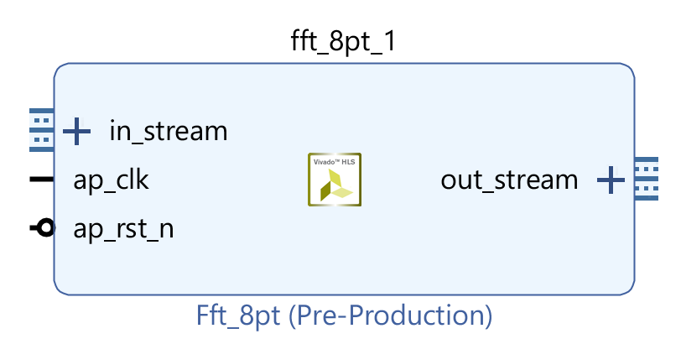
Block Design
This port is used to take the input data from the PS to perform the FFT operation
This port is used to transfer the generated output back to PS
These two ports are used form giving clock signal and reset signal to the FFT

Slide 4
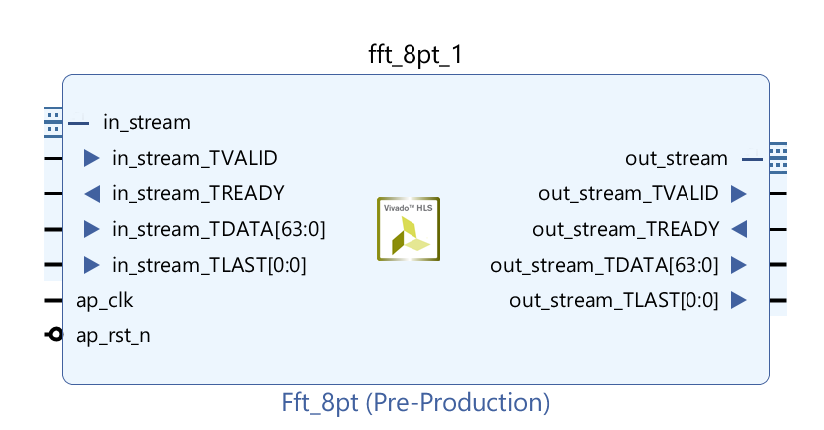
Block Design
Input Stream: This stream consists of 4 ports
TVALID: This port is used to tell the FFT that the given data is correct and it can be processed further.
TREADY: This port is used by FFT IP to sent the Ready signal to the PS which indicate that FFT is ready to process the given data.
TDATA: The data sent by PS is of 64-bits 32-bits for real part and 32-bits for imaginary part.
TLAST: Last signal sent by the PS is to indicate FFT IP that last data which need to be processed has been sent.

Slide 5
Block Design
Output Stream: This stream consists of 4 ports
TVALID: This port is used to sent the signal to the PS that the given data is correct.
TREADY: This port get the ready signal from PS, that indicate it is ready to take the data.
TDATA: The data processed by FFT is of 64-bits 32-bits for real part and 32-bits for imaginary part, which is sent by this port.
TLAST: Last signal sent by the FFT is used to indicate PS that last data has been sent.

Slide 6
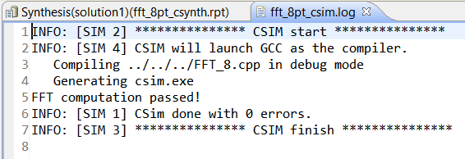
Results
After completing the code for FFT synthesis we run C simulation
C simulation: This process is used the verify the functionality of hardware design. This step ensures that the code behaves as intended and produces the correct outputs for given inputs.
After successfully completing the C-simulation step we run C synthesis which convert the C++ code to Hardware Description Language (HDL) Verilog.
After competing all these we finally export the synthesized FFT IP to Vivado

Slide 7
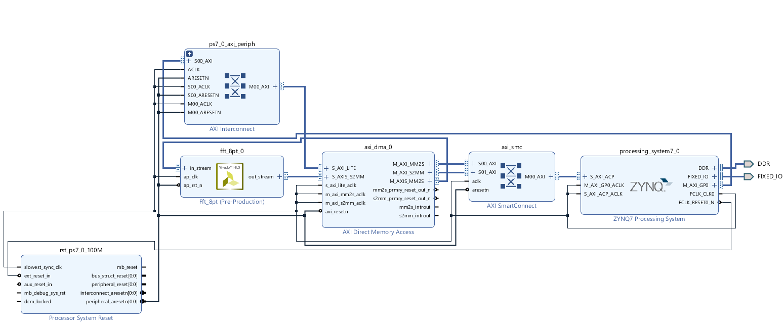
Results
To furthermore verify the functionality of the exported IP, we created the block design to compute the FFT of the 8 complex samples using ZYNQ and compare the outputs of PS and PL(FPGA) part

Slide 8
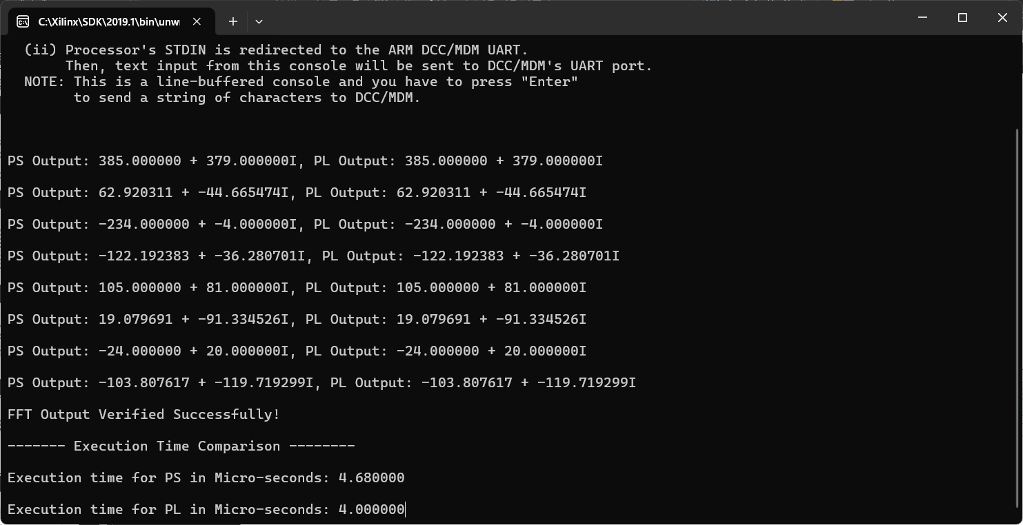
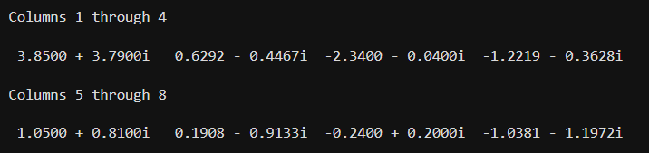
Results and Comparison
Running the FFT on PS and PL:
After running the code in PS and PL we get the same output for PS and PL which verifies that our synthesized IP is running fine.
MATLAB outputs for same inputs
After computing FFT on ARM processor and also on MATLAB we can conclude that our synthesized IP is running fine and our HLS code behaves as intended and produces the correct outputs for given inputs.

Slide 9
Conclusion
This project provided a deep understanding of Vivado HLS tools, which helped me in the development of an 8-point FFT IP. I gained hands-on experience in HLS workflows, simulation, and synthesis. The FFT IP has potential applications in signal processing and communications, with opportunities to expand the design for higher-point FFTs.

Slide 10
References
Cooley, J.W. & Tukey, J. W algorithm for computing Fast Fourier Transform.
Advanced Embedded Logic Design lab 8 from YouTube channel A2A labs to learn Vivado HLS
ChatGPT for optimization and debugging the code

Slide 11
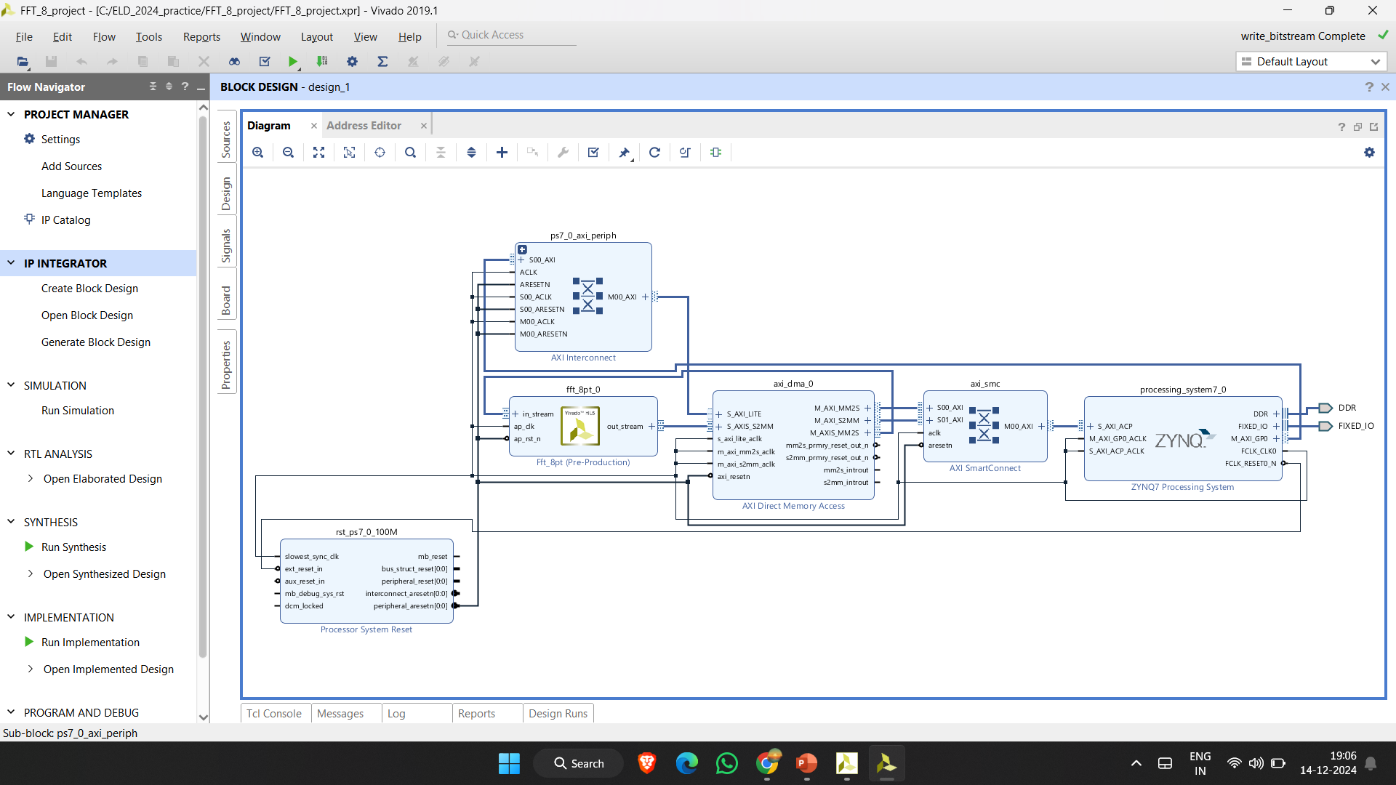
Block Design

Slide 12
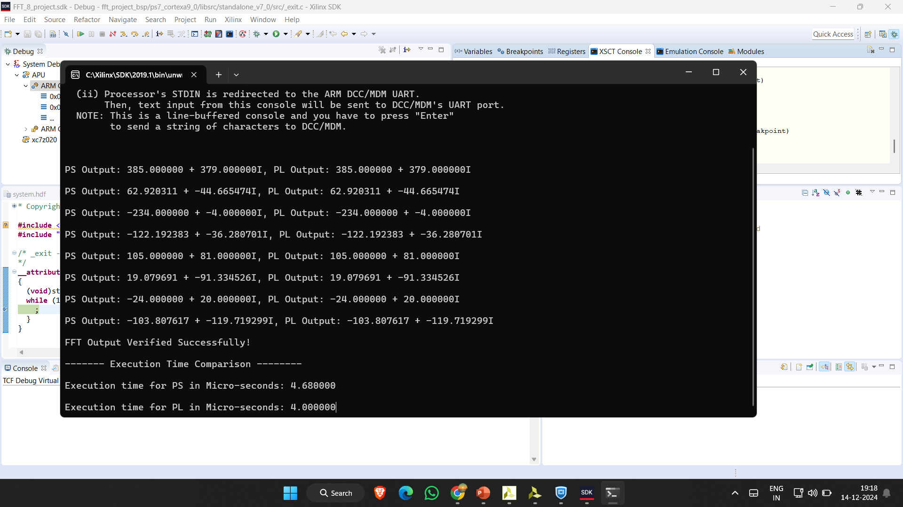
PS and PL output

